Slide 1
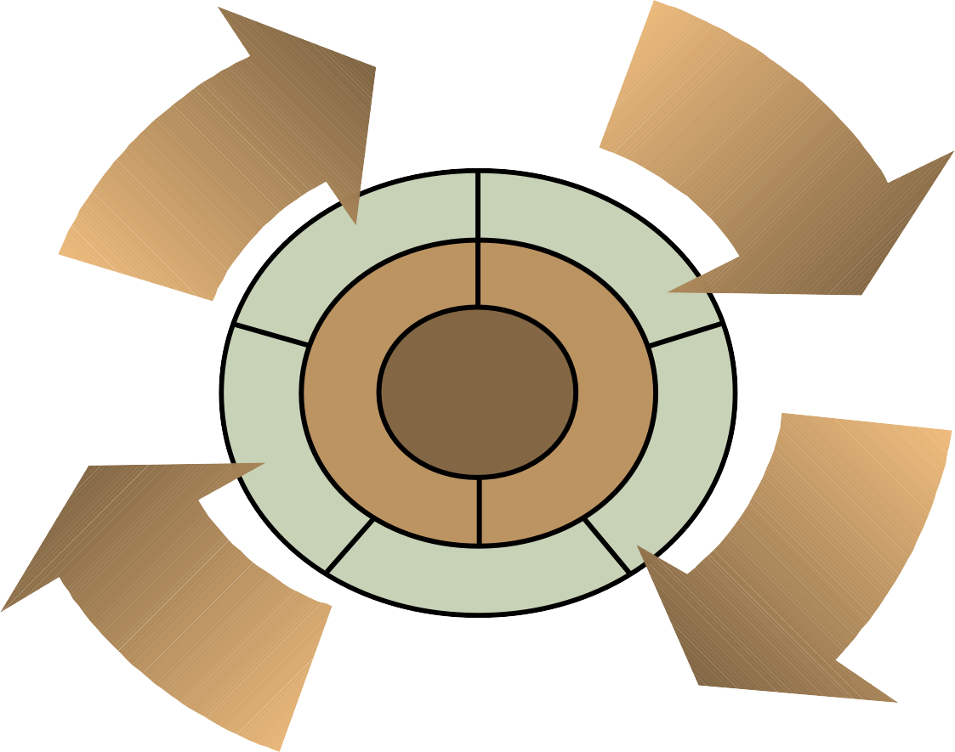

Chapter-4
Quality and Performance
Copyright © 2010 Pearson Education, Inc. Publishing as Prentice Hall.
5 – 1

Slide 2
Meaning of Quality
A term used by customers to describe their general satisfaction with a service or product.
Webster’s Dictionary
degree of excellence of a thing
American Society for Quality
totality of features and characteristics that satisfy needs
5 – 2

Slide 3
Dimensions of Quality: Manufactured Products
Quality in manufacturing organizations is often different from that of services. Manufacturing organizations produce a tangible product that can be seen, touched, and directly measured. The dimension of quality of manufactured products are:
Performance
Reliability
Conformance (standard of something)
Durability
Serviceability
Aesthetics (Pleasing in appearance)
Safety
Perceptions

Slide 4
Dimensions of Quality: Service
Every industry has different service quality standards. After all, you don’t expect the same type of service from a hotel and a retail store. And service quality also varies by brand promise, as a five-star resort has very different expectations than a roadside motel. The dimensions of quality in service sectors are given below:
Time and timeliness
Completeness
Courtesy
Consistency
Accessibility and convenience
Accuracy
Responsiveness

Slide 5
Cost of Quality
Defects: Any instance (case) when a process fails to satisfy its customer.
Types of Cost related with Quality
Prevention costs
Appraisal costs
Internal failure costs
External failure costs

Slide 6
1.Prevention Costs
Prevention costs are associated with preventing defects before they happen. It include the following costs:
Quality planning costs- It is the costs of developing and implementing quality management program.
Product-design costs- It is the costs of designing products with quality characteristics.
Process costs- It is the costs expended to make sure productive process conforms to quality specifications.
Training costs- It is the costs of developing and putting on quality training programs for employees and management.
Information costs- It is the costs of acquiring and maintaining data related to quality, and development of reports on quality performance.

Slide 7
2.Appraisal Costs
Appraisal costs are incurred when the firm assesses the performance level of its processes. The costs that it includes are given below:
Inspection and testing- It include the costs of testing and inspecting materials, parts, and product at various stages and at end of process
Test equipment costs- It Include the costs of maintaining equipment used in testing quality characteristics of products.
Operator costs- It include the costs of time spent by operators to gather data for testing product quality, to make equipment adjustments to maintain quality, and to stop work to assess quality.

Slide 8
3.Internal Failure Costs
Internal failure costs result from defects that are discovered during production of services or products. The cost that it includes are given below:
Scrap costs- It includes the costs of poor-quality products that must be discarded, including labour, material, and indirect costs.
Rework costs- It includes the costs of fixing defective products to conform to quality specifications.
Process failure costs- It includes the costs of determining why production process is producing poor-quality products.
Process downtime costs- It includes the costs of shutting down productive process to fix problem.
Price-downgrading costs- It includes the costs of discounting poor- quality products—that is, selling products as “seconds”.

Slide 9
4.External Failure Costs
External failure costs arise when a defect is discovered after the customer receives the service or product. It include the following costs:
Customer complaint costs- It includes the costs of investigating and satisfactorily responding to a customer complaint resulting from a poor-quality product.
Product return costs- It includes the costs of handling and replacing poor-quality products returned by customer.
Warranty claims costs- It includes the costs of complying with product warranties.
Product liability costs- It includes the litigation costs resulting from product liability and customer injury.
Lost sales costs- It includes the costs incurred because customers are dissatisfied with poor quality products.

Slide 10
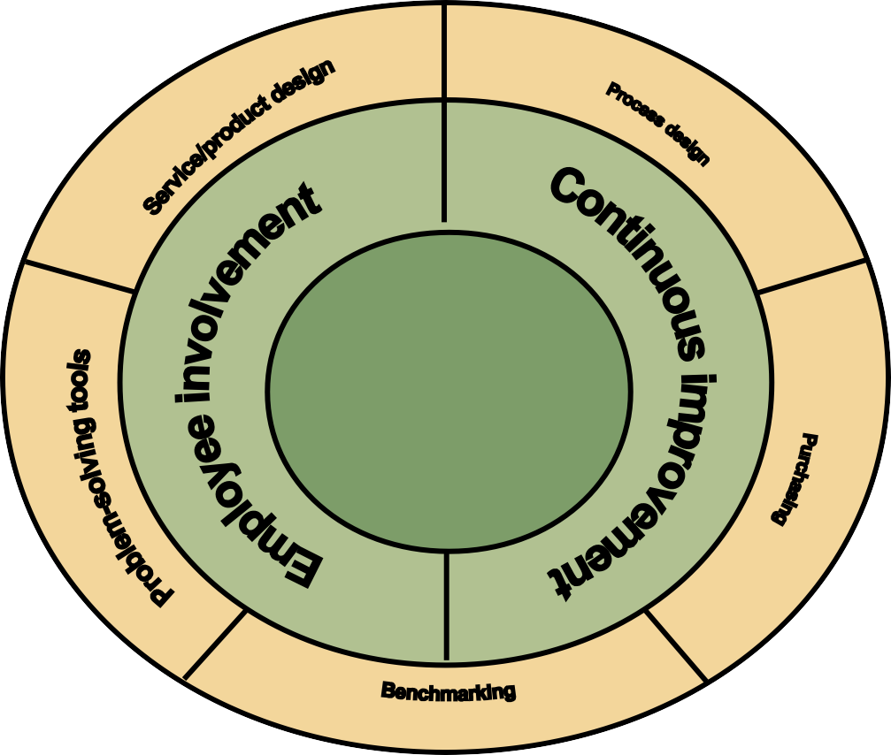
Total Quality Management
Total quality management (TQM):
TQM is a philosophy that stresses three principles for achieving high levels of process and performance quality. The principles are:
Customer satisfaction
Employee involvement
Continuous improvement in performance
Fig: TQM Wheel

Slide 11
1.Customer Satisfaction
Customers, internal or external, are satisfied when their expectations regarding a service or product have been met or exceeded. It includes the following dimension:
Conformance to Specification: How a service or product conforms to the performance specifications.
Value: How well the service or product serves its intended purpose at a price customers are willing to pay.
Fitness for use: How well a service or product performs its intended purpose.
Support: Support provided by the company after a service or product has been purchased.
Psychological impressions: People often evaluate the quality of service or product on the basis of psychological impressions like atmosphere, image, or aesthetics.

Slide 12
2. Employee Involvement
One of the important elements of TQM is employee involvement. It includes changing organizational culture and encouraging teamwork. It includes the following concepts:
Cultural Change- One of the main challenges in developing the proper culture for TQM is to define ‘Customer’ for each employee. The customer can be internal and external. In TQM everyone in the organization must share the view about quality control. It is a philosophy where defects are caught and corrected where they were created which means at source or before handed to customer.
‘Sharing culture’
Teams- Employee involvement is a key tactic for improving processes and quality. One way to achieve employee involvement is by the use of team which is small groups of people who have a common purpose, set their own performance goals and approaches, and hold themselves accountable for success.There are three kinds of teams are used. They are- a)Problem-solving teams b) Special purpose team c) Self managing teams

Slide 13
3. Continuous Improvement
Continuous improvement is the philosophy of continually seeking ways to improve processes based on a Japanese concept called kaizen. The ways to maintain this:
Train employees in the methods of statistical process control (SPC) and other tools.
Make SPC methods a normal aspect of operations.
Build work teams and encourage employee involvement.
Utilize problem-solving tools within the work teams.
Develop a sense of operator ownership in the process.

